Slide 1


Appendix 1 | Python & Pandas
import pandas as pd
some_list = [0, 3, 6, 9, 12, 15, 18, 21, 24, 27]
some_list = []
for i in range(0,10):
some_list.append(i*3)
some_list = [i*3 for i in range(0,10)]
Ways to iterate
data = [
{'id':1, 'value':0},
{'id':2, 'value':3},
{'id':3, 'value':6},
{'id':4, 'value':9},
]
df = pd.DataFrame(data)
df['value_modified'] = df.value*10
=
Data Structures
Reading files
some_text_file = open('some_file.anyextension','r').read()
denominator = 0
try:
some_division = 2/denominator
except:
print('divided by 0! diveded by 1 instead’)
some_division = 2/1
Catching/Managing errors

Slide 2
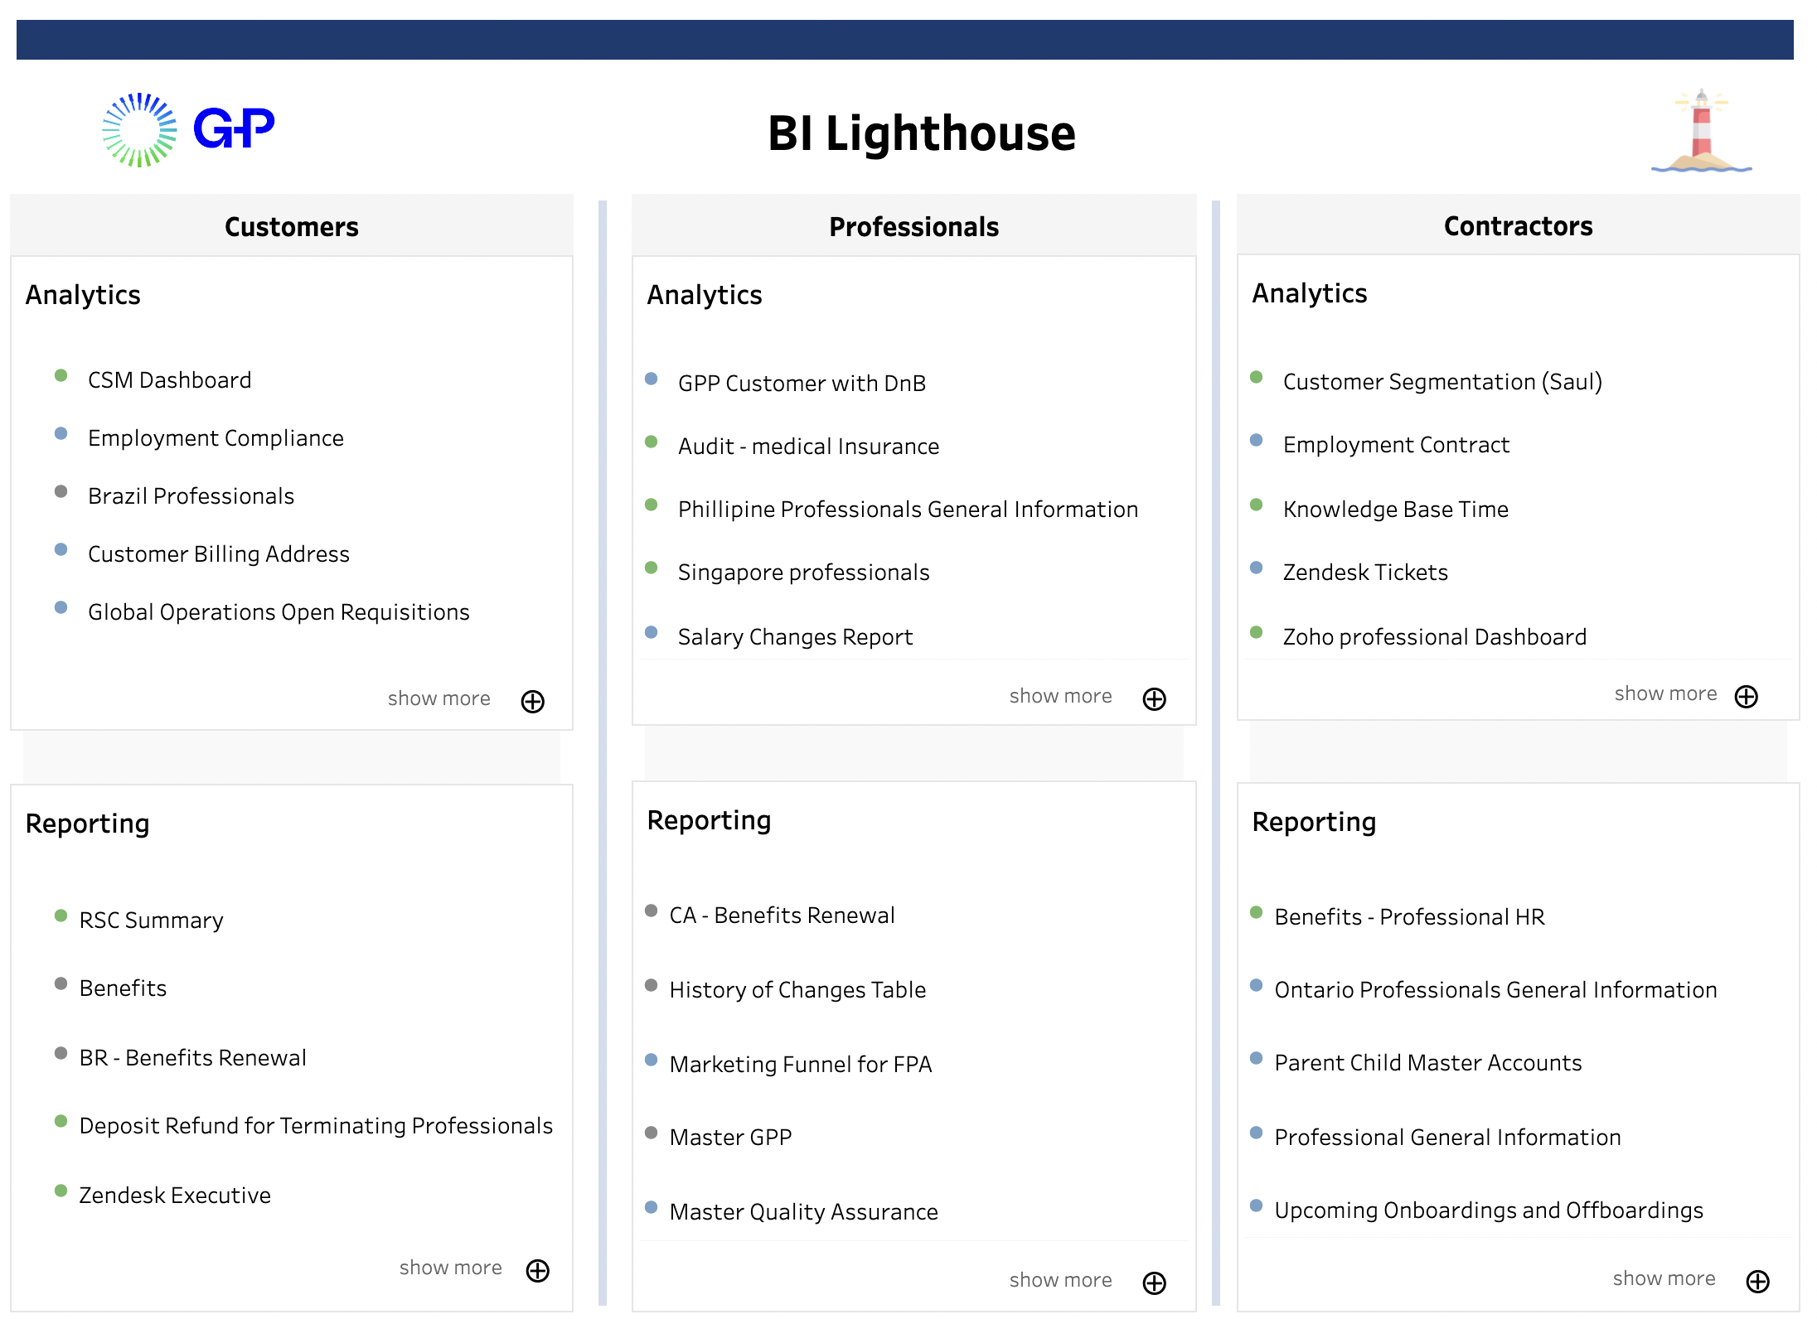
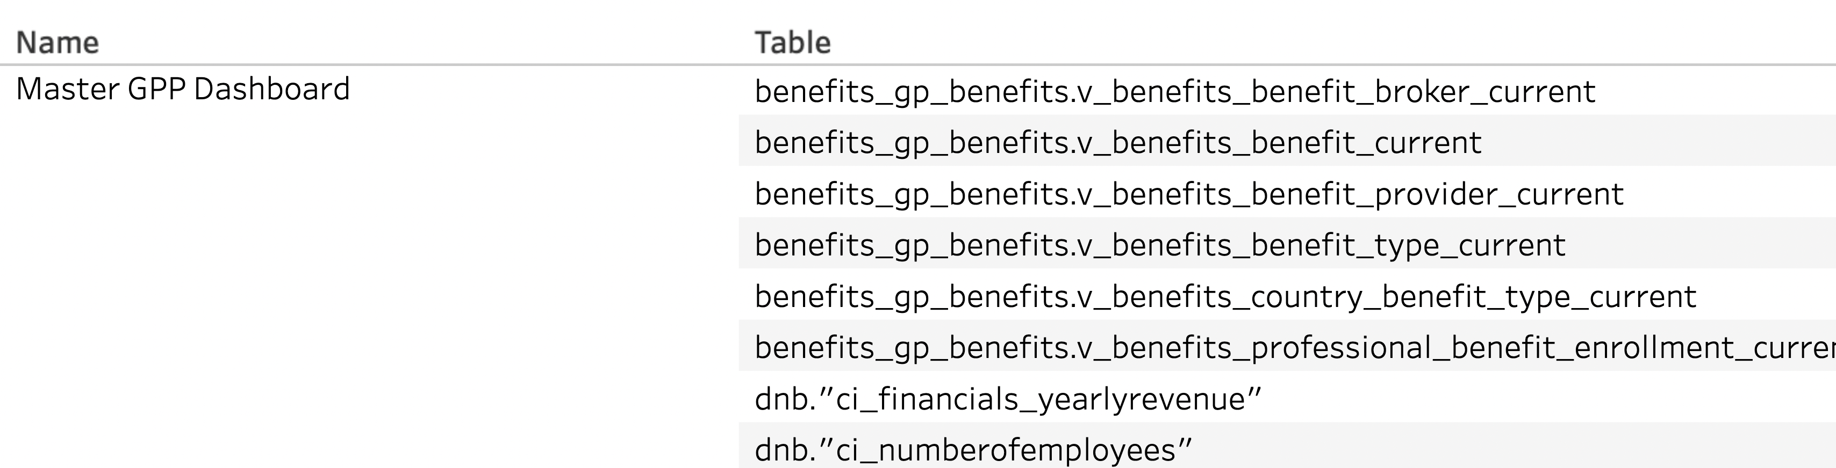
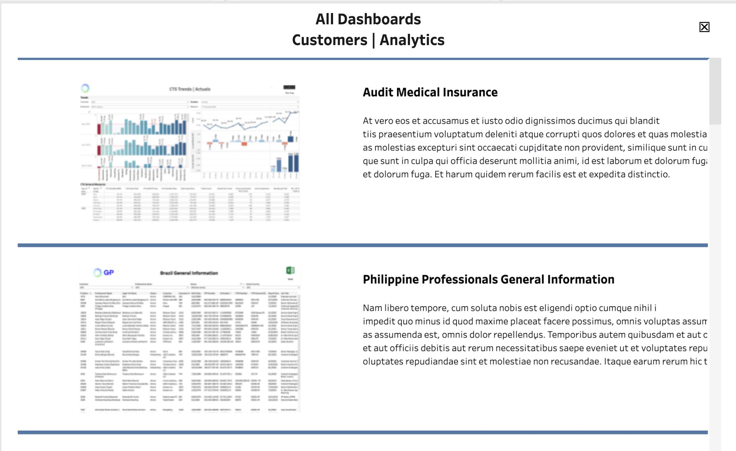
Tableau Metadata API Use Cases
BI Lighthouse Project (Landing Page)
Workbook Data Sources
Workbook
Name
View Count
Workbook
Name
Tables used in connections &
custom queries
Description
Owner
Parent Folder
Thumbnail

Slide 3
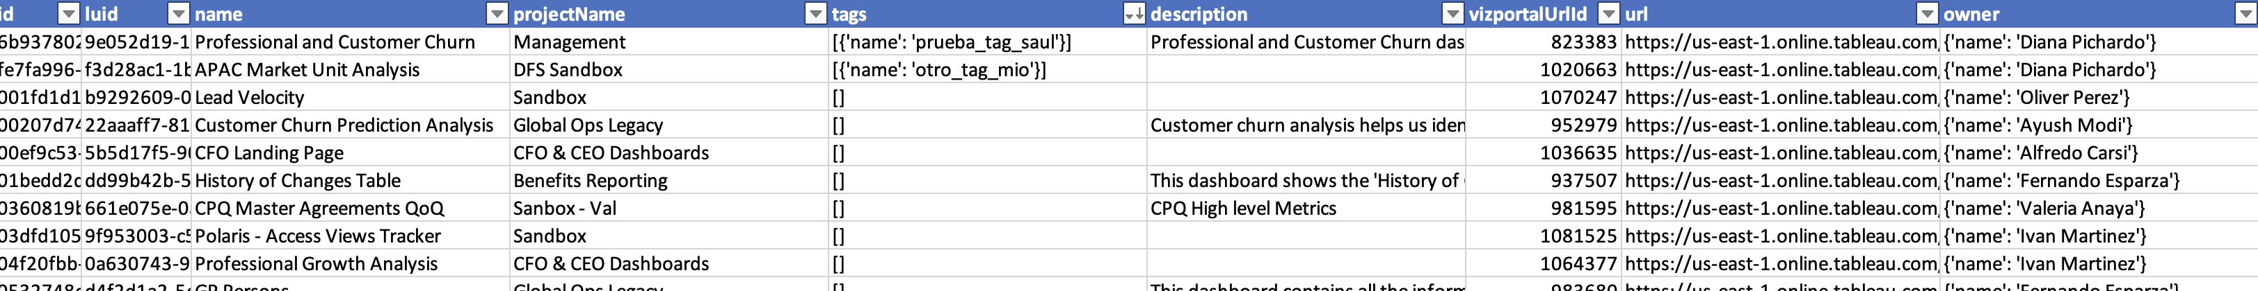
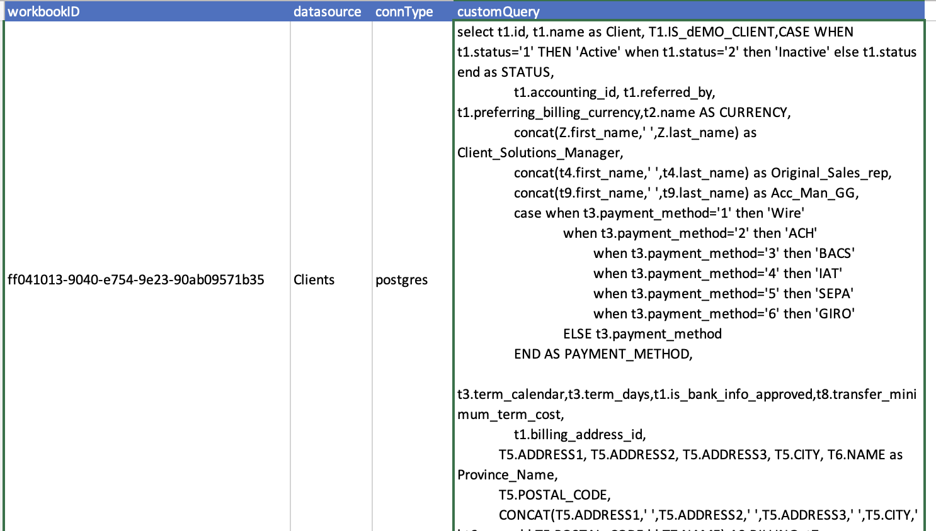
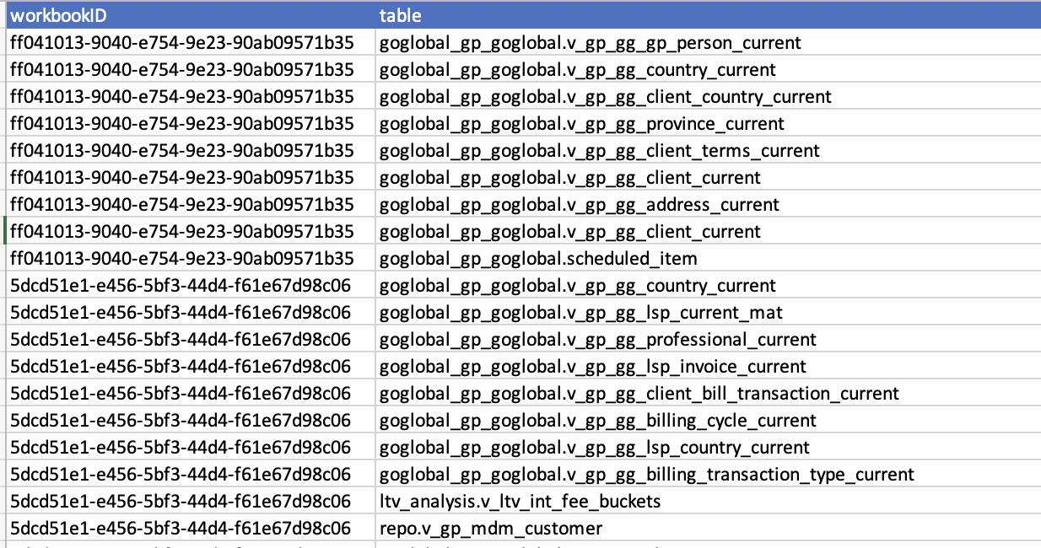
Data Structures Motivation
3 tables hold all the info needed to feed these use cases. They’re created in order, one after another.
WORKBOOK GENERAL DATA
CUSTOM QUERIES
3. CUSTOM QUERIES

Slide 4
Custom Query Data Extraction
custom_query.graphql
Instructions needed to get the custom queries for some workbook represented by their ${id}
query EmbeddedDS{
workbooks
(filter: {id:"${id}"})
{
id
embeddedDS: embeddedDatasources{
datasourceName: name
fields {
fieldName: name
...on ColumnField{
columns{
table{
...on CustomSQLTable{
customSQLName: name
connectionType
query
}
}
}
}
}
}
}
}
=

